Slide 1
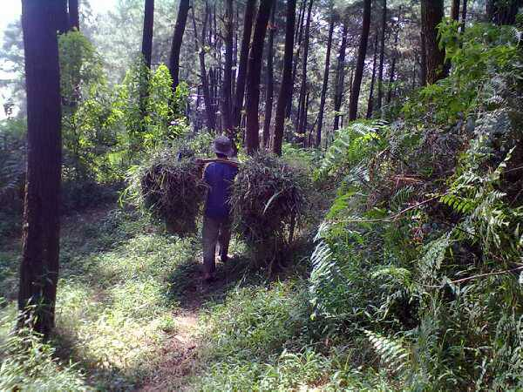
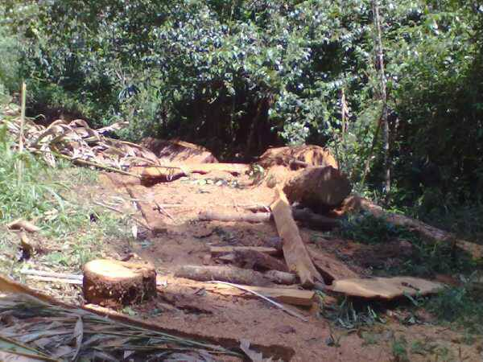



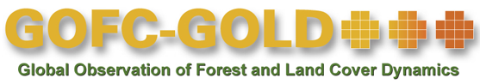
Module 2.2 Monitoring activity data for forests remaining forests (incl. forest degradation)
Module developers:
  Carlos Souza, Imazon
  Sandra Brown, Winrock International
  Jukka Miettinen, European Commission (EC)–Joint Research Centre (JRC)
  Frédéric Achard, EC–JRC
  Martin Herold, Wageningen University
After the course the participants should be able to:
Describe different types of forest degradation and
the approaches to monitor degradation
Map and analyze various forest degradation processes using ground surveys and the remote sensing tools provided in the module
V1, May 2015
Creative Commons License

Slide 2
Background material
GOFC-GOLD. 2014. Sourcebook. Section 2.2.
GFOI. 2014. Integrating Remote-sensing and Ground-based Observations for Estimation of Emissions and Removals of Greenhouse Gases in Forests: Methods and Guidance from the Global Forest Observation Initiative (MGD). Sections 2.2.2 and 3.
Souza. 2012. “Monitoring of Forest Degradation.” In Global Forest Monitoring from Earth Observation.
Morton, D., et al. 2011. “Historic Emissions from Deforestation and Forest Degradation in Mato Grosso, Brazil: 1) source data uncertainties”
Simula. 2009. “Towards Defining Forest Degradation: Comparative Analysis Of Existing Definitions.” Working Paper 154, FAO.
Herold et al. 2011. “Options for Monitoring and Estimating Historical Carbon Emissions from Forest Degradation in the Context of REDD+.” Carbon Balance and Management.
Pearson, Brown, and Casarim. 2014. “Carbon Emissions from Tropical Forest Degradation Caused by Logging.” Environmental Research Letters.

Slide 3
Outline of lecture
Definition of forest degradation and IPCC GPG* context
Types of forest degradation
Approaches to assess forest degradation areas:
  Monitoring forest degradation from selective logging
  Monitoring forest degradation from fuelwood collection
  Remote sensing approaches:
    direct methods
    indirect methods
Software requirements
*GPG = Good Practice Guidance

Slide 4
Outline of lecture
Definition of forest degradation and IPCC GPG* context
Types of forest degradation
Approaches to assess forest degradation areas
  Monitoring forest degradation from selective logging
  Monitoring forest degradation from fuelwood collection
  Remote sensing approaches
    direct methods
    indirect methods
Software requirements
*GPG = Good Practice Guidance

Slide 5
Degradation: Introduction
Forest degradation (changes in forests remaining forests) leads to a long-term/persistent decline in carbon stock.
Emission levels per unit area are lower than for deforestation; cumulative and secondary effects can result in significant carbon emissions.
Monitoring forest degradation is important to avoid displacement of emissions from reduced deforestation.
More severe degradation (area/intensity) usually results in more distinct indicators for efficient national monitoring.

Slide 6
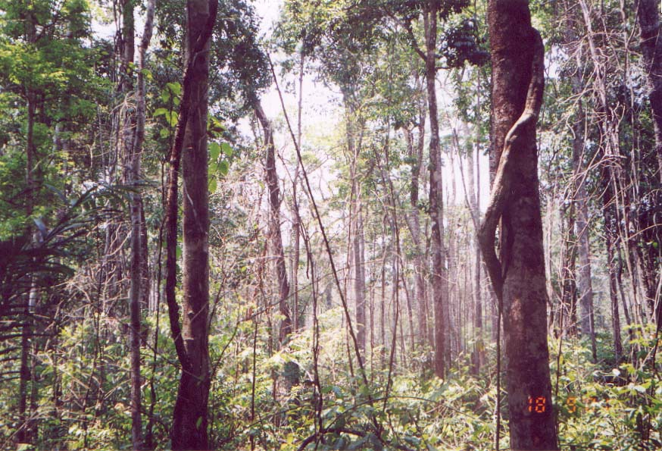
Defining forest degradation
Over 50 definitions have been identified in the scientific literature (Simula 2009; Herold 2011).
Broadly speaking, forest degradation is a type of anthropogenic intervention that leads to changes in forest cover, structure and/or composition, and function of the original forest.
Changes can be temporary or permanent.
Changes can affect biodiversity, carbon stocks, hydrological and biogeochemical cycles, soil, and other environmental services.
Example of forest degradation caused by recurrent logging and fires in Sinop region, Mato Grosso state, Brazil.
Notes:
Temporary changes are a point of discussion. How can it be degradation if the forest recovers in < 5 years. How can this be significant?
Sources:
Simula 2009;
Herold et al. 2011.

Slide 7
Earlier IPCC definition of forest degradation
For the purpose of the UN Convention on Climate Change, IPCC defined forest degradation in 2003 based on removal of forest carbon stocks:
  “A direct, human-induced, long-term loss (persisting for X years or more) or at least Y% of forest carbon stocks [and forest values] since time T and not qualifying as deforestation”
  (X, Y, and T have not been defined.)

Slide 8
Definition in terms of REDD+
General guidance from SBSTA expert meeting (UNFCCC 2008):
  “Degradation leads to a loss of carbon stock within forests that remain forests”
Definition of forests directly affects definition of forest degradation (... within remaining forest)
Several processes lead to forest degradation: logging, fuelwood collection, fire, forest grazing etc.
From a monitoring perspective it is important to consider what type/process of degradation to be assessed:
  Different types of degradation may require different methods and data for monitoring
Notes:
Source:
UNFCCC 2008.

Slide 9
Outline of lecture
Definition of forest degradation and IPCC GPG* context
Types of forest degradation
Approaches to assess forest degradation areas
  Monitoring forest degradation from selective logging
  Monitoring forest degradation from fuelwood collection
  Remote sensing approaches
    direct methods
    indirect methods
Software requirements
*GPG = Good Practice Guidance

Slide 10
Forest degradation & impact on carbon stocks
Human-induced disturbance causes loss of forest: fire (red line), clearing (orange), logging (grey).
Forest degradation is mostly associated with logging (i.e., predatory or unplanned) and forest fires.
Shifting cultivation and plantation forestry balance out carbon stocks over time.
Natural regrowth
Primary forest
Continuous logging
Further disturbances:
Prevented regrowth,
fire/storm/pests
Carbon stock (aboveground)
Plantation forestry
Agroforestry
Shifting cultivation
Deforestation
Time
Notes:
Conceptual depiction (not real data) of impact on aboveground carbon stocks of different types of forest degradation.

Slide 11
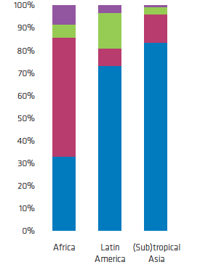
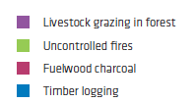
Important direct drivers of degradation
Proportion of forest degradation drivers
Latin America and (sub)tropical Asia:
Commercial timber production > 70% of total degradation
Africa:
Fuel wood collection, charcoal production, followed by timber production
Source:
Hosonuma et al., 2012
Notes:
Source:
Hosonuma et al. 2012.
More information on the magnitude of emissions from different degradation drivers are available in Pearson, T. R. H, S. Brown, L.T. Murray, and G. Sidman. 2017. “Greenhouse gas emissions from tropical forest degradation: an underestimated source.” Carbon Balance and Management 12:3 https://link.springer.com/article/10.1186%2Fs13021-017-0072-2

Slide 12
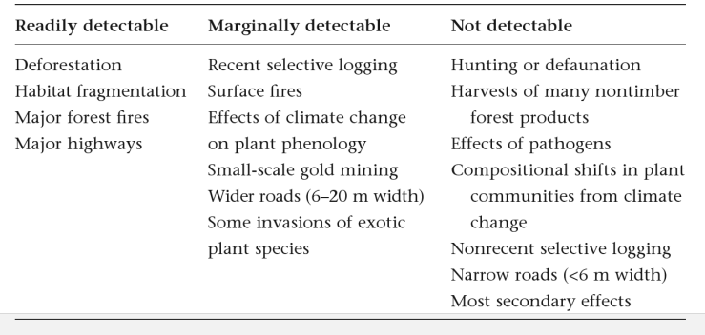
Detectability of forest degradation
Forest degradation can be caused by one or a combination of anthropogenic threat(s) and detectability by earth observation systems is not always possible
Detectability of different threats to tropical forests using available medium- resolution remote-sensing techniques
Source:
Laurence and Peres 2006.
Notes:
Marginally detectable threats are those that can be detected, at least partially, using high-resolution methods or specialized detection algorithms that are expensive, technically challenging to implement, and available only for limited or specific areas.
Source:
Laurance and Peres 2006.

Slide 13
Outline of lecture
Definition of forest degradation and IPCC GPG* context
Types of forest degradation
Approaches to assess forest degradation areas
  Monitoring forest degradation from selective logging
  Monitoring forest degradation from fuelwood collection
  Remote sensing approaches
    direct methods
    indirect methods
Software requirements
*GPG = Good Practice Guidance

Slide 14
Options for monitoring historical forest degradation
Activity/driver of degradation | Activity data (on national level)
Extraction of forest products for subsistence and local markets, such as fuel wood and charcoal | Limited historical data Information from local scale studies or using proxies (population density, household consumption, etc.) Only long-term cumulative changes may be observed from historical satellite data
Industrial/commercial extraction of forest products, such as selective logging | Harvest data and statistics Historical satellite data (Landsat time series) analysed within concession areas Direct approach should be explored for recent years
Other disturbances such as (uncontrolled) wildfires | Historical satellite-based fire data records (since 2000) to be analysed with Landsat-type data
Source: Herold et al. 2011.

Slide 15
Common sources for activity data for forest degradation
Field observations and surveys (module section 3i):
  Inventory-based approaches (national, subnational)
  Data from targeted field surveys (incl. interviews), research, and permanent sample plots
  Commercial forestry data (i.e., logging concessions and timber extraction rates)
  Proxy data for domestic markets and demands (charcoal, fuel wood, subsistence)
Remote sensing (module section 3ii):
  Direct detection of degradation processes (forest canopy damage)
  Indirect approaches (observe human infrastructure)
  Fire monitoring (active fire and burned area, see also Module 2.6)

Slide 16
Outline of lecture
Definition of forest degradation and IPCC GPG* context
Types of forest degradation
Approaches to assess forest degradation areas
  Monitoring forest degradation from selective logging
  Monitoring forest degradation from fuelwood collection
  Remote sensing approaches
    direct methods
    indirect methods
Software requirements
*GPG = Good Practice Guidance

Slide 17
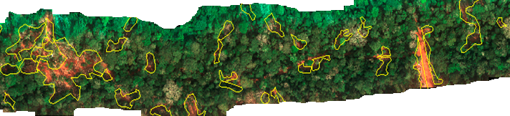
Forest Degradation from Selective Logging
Canopy reduction from:
  Gaps created by felled and collaterally damaged trees
  Clearings for roads, decks, and skid trails
Damage is often not contiguous.

Slide 18
How to estimate emissions from timber harvesting practices
Two basic methodologies based on IPCC framework:
  Combination of timber extraction rates, management plans, and high-resolution imagery for activity data (AD) and gain-loss for emission factors (EF) (See also Module 2.3)
  Remote sensing using medium-resolution imagery for AD and stock-change method for EF (See module section 3.ii)

Slide 19
Example for selective logging
Emissions due to selective logging are estimated as:
EF (t C/m3) = ELE + LDF + LIF
Where:
  ELE = extracted log emissions (t C/m³ extracted)
  LDF = logging damage factor, or dead biomass carbon left behind in gap from felled tree and incidental damage (t C/m³ extracted)
  LIF = logging infrastructure factor, or dead biomass carbon caused by construction of infrastructure (t C/m³)
Field data are collected to quantify the ELE and LDF from multiple logging gaps.
Activity data for this method is total volume extracted from the forest per year, but to obtain AD one may have to use a combination of field data and very high resolution remote sensing imagery.
Notes:
This is the standard equation used to estimate emissions from selective logging. Quantifying the factors determines the types of field data that need to be collected.
Source:
Pearson, Brown, and Casarim. 2014. Carbon emissions from tropical forest degradation caused by logging. Environmental Research Letters 9. https://www.winrock.org/wp-content/uploads/2016/03/Pearson-et-al-2014-Logging.pdf

Slide 20
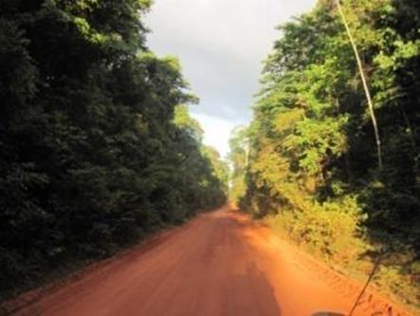
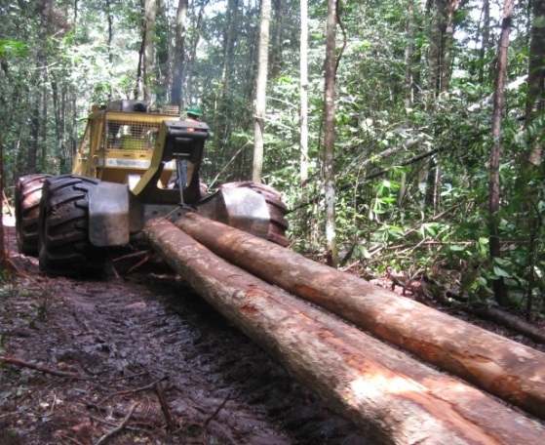
Estimating AD for selective logging from harvesting data
Selective logging methodology (Module 2.3) requires quantifying the Logging Infrastructure Factor:
  The LIF is the sum of the C impact of: skid-trails + roads + decks
  The C impact is estimated as the product of C stock estimates of unlogged forest areas and the area of infrastructure
  The LIF can be normalized to emissions per unit of volume extracted by dividing emissions by harvested volume in m³
Notes:
The logging infrastructure factor estimates the C emissions from the infrastructure built to support selective logging activities.

Slide 21
Potential problem: Obtaining reliable amount of timber extracted per unit area per year
How reliable are national data:
  Presence of FLEGT program on log tracking?
  Illegal logging?
  Extract more than allowable cut?
Can use an independent method—aerial imagery using a sampling approach produces estimates of area of gaps caused by trees felled and other impacts:
  Based on field data in logging plots, it can obtain data on m³ of timber extracted from the gap per m² of gap area
Notes:
FLEGT stands for Forest Law Enforcement, Governance and Trade. For more info, see: http://www.euflegt.efi.int/about-flegt
Ideally, you would produce reliable estimates of the quantity of timber extracted per year, either total for all concessions or for the total area under harvest in a given year (in m3/ha). For some countries, especially those that use a log tracking system (e.g., bar codes on logs and stumps), the estimates would be reliable.
If estimates are unreliable, there are methods available that could be used to obtain such data. These methods are presented in next few slides

Slide 22
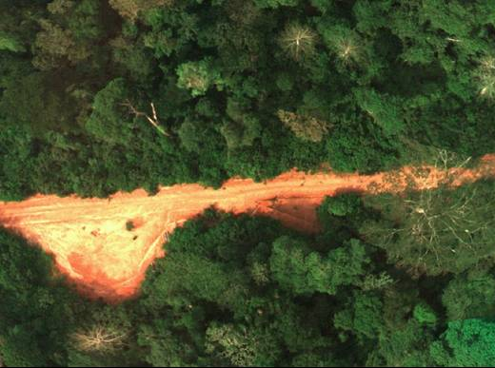
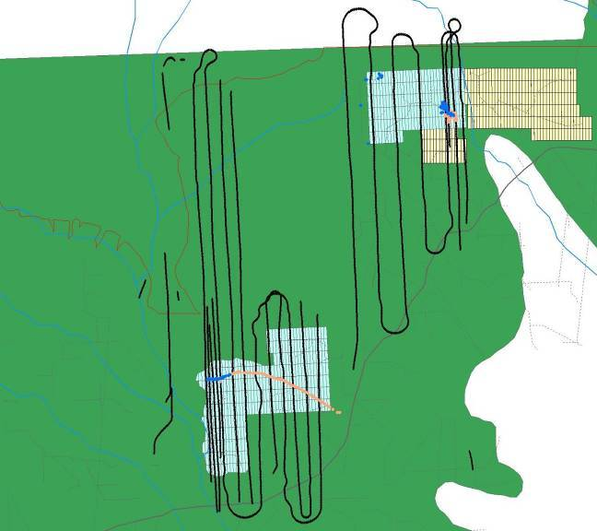
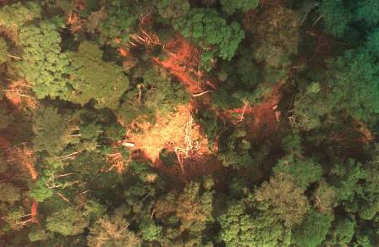
Option: Fly aerial transects over concession to monitor logging damage
Resolution of 15-20 cm
Active concessions in blue
Notes:
This approach uses very high resolution aerial imagery at about 15 cm resolution captured as overlapping images, so that if one has the right hardware it can be seen in 3D (uses ERDAS software and some special goggles). This approach is done by sampling the active concessions and identifying logging gaps and other infrastructural damage. The imagery is collected with fairly simple equipment (commercial providers exist) and can be flown in a single engine plane under clouds at about 1,000-1,500 feet above ground surface; the height above ground reflects the resolution of the imagery.

Slide 23
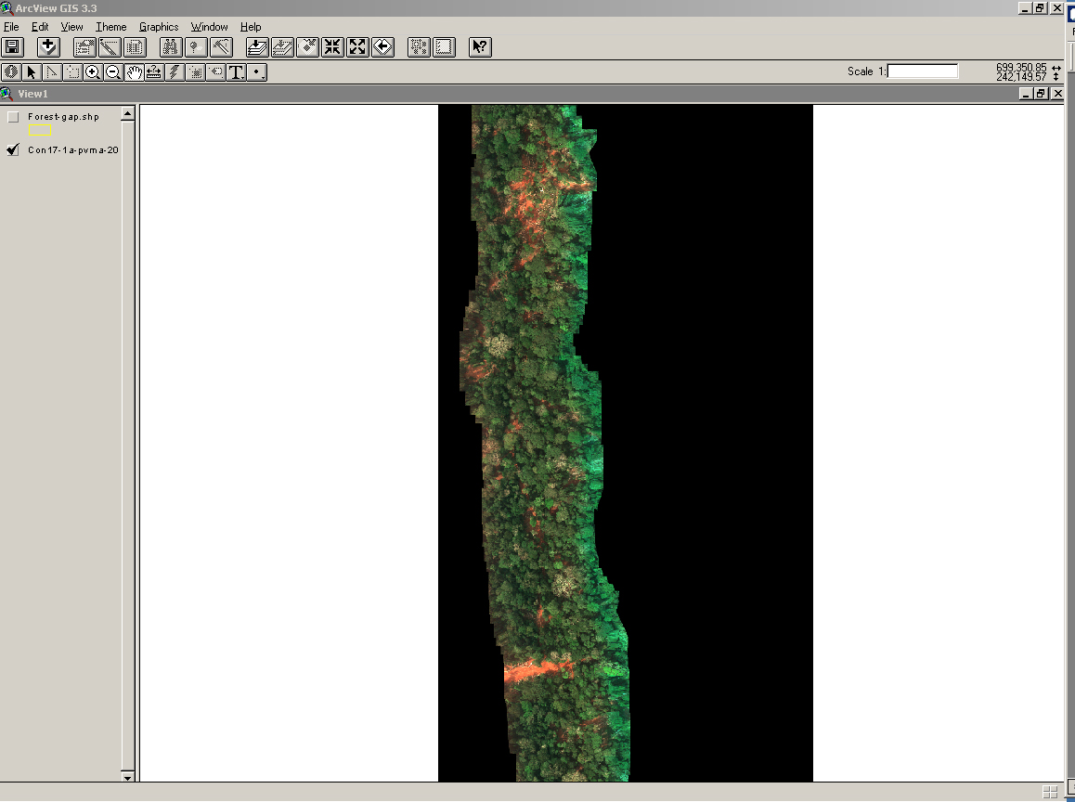
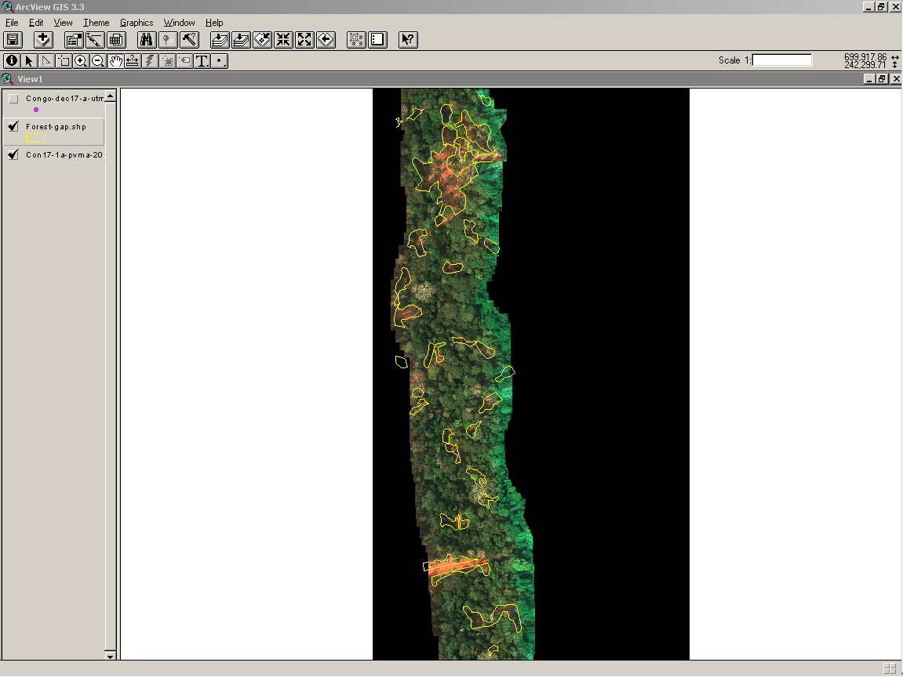
Strips of aerial imagery showing logging damage
Image with gaps are delineated automatically with eCognition.
Uses imagery to estimate area of gaps formed by felled trees and uses relation between volume (m³) extracted per area of gap (m²) (from field data).
Measures area of roads and log landings and length of skid trails.
Estimates proportion of total sample area covered by gaps, and proportion of total active concession sampled with image strips:
  Estimates total volume extracted and logging infrastructure area/length
Notes:
The imagery can be used to obtain the area of gaps, using the program eCognition. Then with ground work one can ascertain the total volume extracted as well as total area of all infrastructural damage.

Slide 24
Outline of lecture
Definition of forest degradation and IPCC GPG* context
Types of forest degradation
Approaches to assess forest degradation areas
  Monitoring forest degradation from selective logging
  Monitoring forest degradation from fuelwood collection
  Remote sensing approaches
    direct methods
    indirect methods
Software requirements
*GPG = Good Practice Guidance

Slide 25
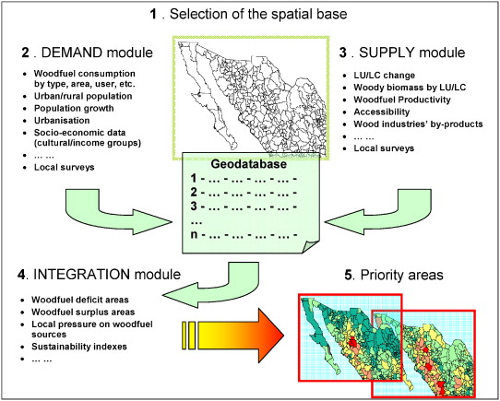
Using spatial analysis to model fuel wood supply and demand
LU/LC = land use /
land cover
Source: Ghilardi et al. 2007.
Notes:
Another option is to use spatial analysis to model fuel wood supply and demand in order to calculate total area and volume of wood extracted.
Source:
Ghilardi, Guerrero, and Masera 2007.

Slide 26
Outline of lecture
Definition of forest degradation and IPCC GPG* context
Types of forest degradation
Approaches to assess forest degradation areas
  Monitoring forest degradation from selective logging
  Monitoring forest degradation from fuelwood collection
  Remote sensing approaches
    direct methods
    indirect methods
Software requirements
*GPG = Good Practice Guidance

Slide 27
Satellite remote sensing methods
There are several remote sensing techniques developed to map the main types of forest degradation.
The choice of remote sensing method depends on:
  Type and intensity of degradation
  Spatial and temporal extent of the problem
Two basic approaches:
  Direct Methods (module section 3iia): Assessing canopy damage using time series data to detect and map degraded forests
  Indirect Methods (3iib): Estimating the forest area affected by forest degradation detecting human infrastructure as proxy (and combine with GIS analysis)

Slide 28
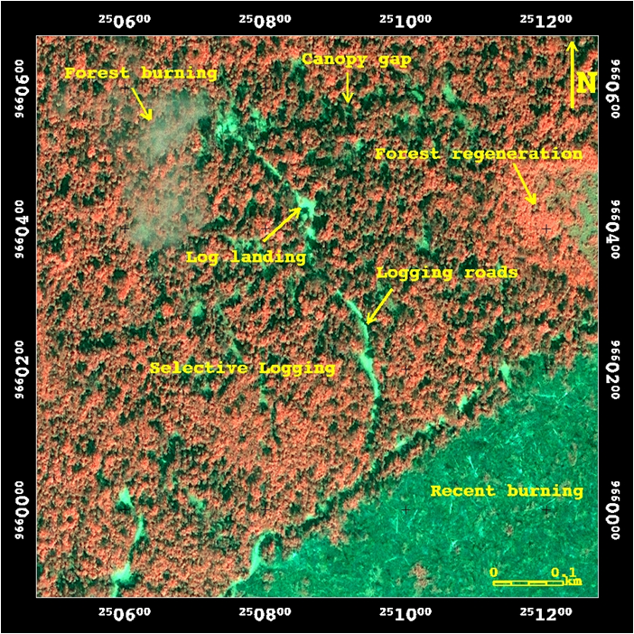
Challenges to defining forest degradation
Forest degradation can have many effects on the forest canopy.
Forest degradation creates a mixture of environments, including undisturbed forests, small clearings, and old degraded forests (i.e., forest regeneration) in remote sensing images.
Based on Sourcebook 2014.
Figure 2.2.1

Slide 29
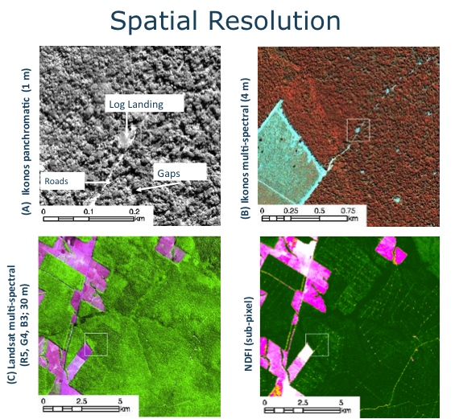
Remote sensing methods
Very high spatial resolution imagery facilitates visual detection of forest degradation.
Medium spatial resolution imagery with a higher number of spectral bands, such as Landsat, can be useful to map and monitor forest degradation with high temporal coverage.
Based on Sourcebook 2014.
Figure 2.2.3

Slide 30
Examples of remote sensing methods to map selective logging and burning in the Brazilian Amazon
Mapping approach | Sensor | Spatial extent | Objective | Advantages | Disadvantages
Visual interpretation | Landsat TM5 | Local | Map total logging area | Does not require sophisticated image processing techniques. | Labor intensive for large areas and may be user biased to define the boundaries.
 | Landsat TM5 | Brazilian Amazon
Detection of logging landings + buffer | Landsat TM5 e ETM+ | Local | Map total logging area (canopy damage, clearings, and undamaged forest). | Relatively simple to implement and satisfactorily estimate the total logging area. | Logging buffers varies across the landscape, and this approach does not reproduce the actual shape of the logged area.
Decision tree | SPOT 4 | Local | Map forest canopy damage associated with logging and burning. | Simple and intuitive classification rules. | It has not been tested in very large areas and classification rules may vary across the landscape.
Based on Sourcebook 2014. Table 2.2.1

Slide 31
Examples of remote sensing methods (cont.)
Mapping approach | Sensor | Spatial extent | Objective | Advantages | Disadvantages
Change detection | Landsat TM5 e ETM+ | Local | Map forest canopy damage associated with logging and burning. | Enhances forest canopy damaged areas. | Requires two pairs of images and does not separate natural and anthropogenic forest changes.
Image segmentation | Landsat TM5 | Local | Map total logging area (canopy damage, clearings, and undamaged forest). | Relatively simple to implement and satisfactorily estimate the total logging area. Free software available. | It has not been tested in very large areas, and segmentation rules may vary across the landscape.
Carnegie Landsat Analysis System (CLAS) | Landsat TM5 e ETM+ | Three states of the Brazilian Amazon (PA, MT and AC) | Map total logging area (canopy damage, clearings, and undamaged forest). | Fully automated and standardized to very large areas. | Requires very high computation power and pairs of images to forest change detection. Tested only with Landsat ETM+
Normalized Differencing Fraction Index (NDFI)+ Contextual Classification Algorithm (CCA) | Landsat TM5 e ETM+ | Local | Map forest canopy damage associated with logging and burning. | Enhances forest canopy damaged areas. | It has not been tested in very large areas and does not separate logging from burning damages.
Based on Sourcebook 2014. Table 2.2.1

Slide 32
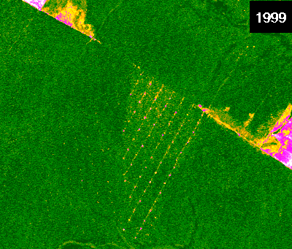
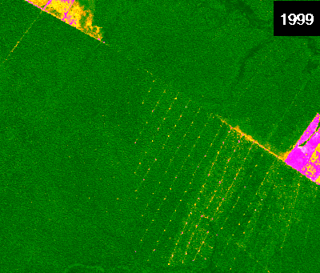
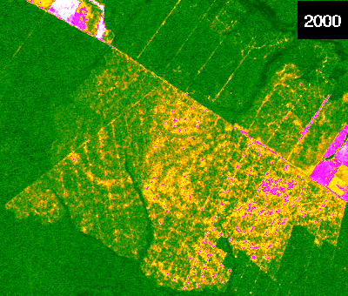
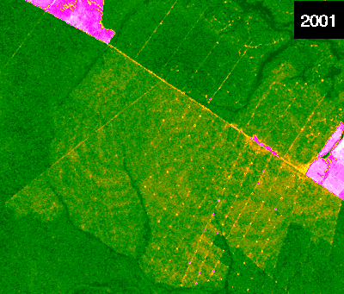
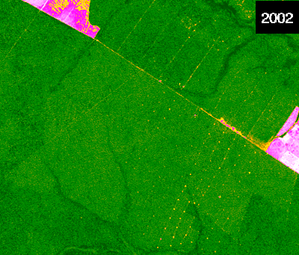
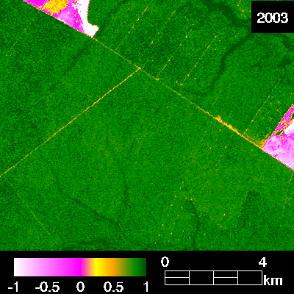
Dynamics of forest degradation
b
a
1998
Old
Logged
Logged
Forest degradation signal changes fast.
There is a synergism of forest degradation processes that can reduce more C stocks of degraded forests.
Recurrent forest degradation is expected and creates even more loss of C stocks.
Annual monitoring is required to keep track of forest degradation process.
Logged
c
d
Logged and Burned
Logged and Burned
e
f
Old Logged and Burned
Old Logged and Burned
Based on Sourcebook 2014.
Figure 2.2.6

Slide 33
Outline of lecture
Definition of forest degradation and IPCC GPG* context
Types of forest degradation
Approaches to assess forest degradation areas
  Monitoring forest degradation from selective logging
  Monitoring forest degradation from fuelwood collection
  Remote sensing approaches
    direct methods
    indirect methods
Software requirements
*GPG = Good Practice Guidance

Slide 34
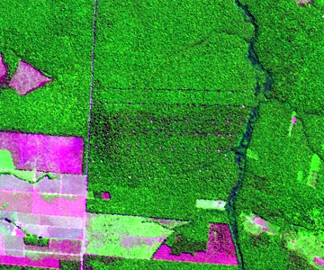
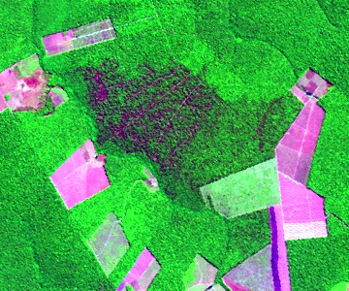
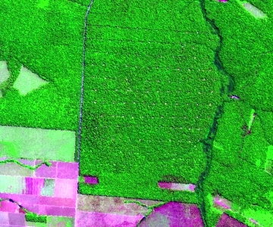
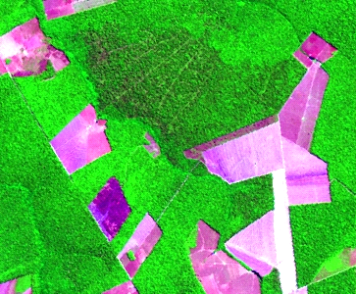
Visual interpretation of forest degradation
Examples of selective logging and logged and burned forests in the Sinop region, Mato Grosso, Brazil.
Defining the boundary between degraded and undisturbed forests is subjective.
Old forest degradation scars cannot be detected visually.
Forest degradation signal disappears fast (see slide 31), making visual interpretation challenging.
1998
2000
Selective
Selective
logging and burning
logging
1999
2001
Old selective
Old Selective
logging and
burning
logging
Landsat false color composite (R5, G4, B3)

Slide 35
Spectral mixture analysis (SMA)
Subset of Ikonos Image
The most common spectrally pure materials (i.e., endmembers) found in degraded forests are:
  Green vegetation
  Soil
  Nonphotosynthetic vegetation (NPV)
  Shade
Mixed pixels predominate in degraded forests.
Landsat Mixed Pixel
(30 m x 30 m)
Shade
Vegetation
Soil
NPV
Notes:
Spectrally pure means: a remote sensing signal which refers only to one type of material (e.g. only to green vegetation). The signal is not mixed with other type of materials (e.g. green vegetation mixed with soil). A pure signal is called an endmember.

Slide 36
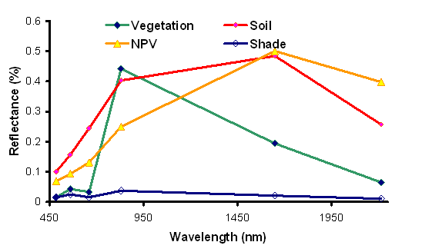
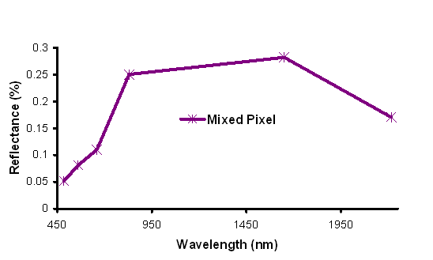
Landsat mixed pixel
Image Endmembers
SMA has been proposed to overcome the mixed pixel problem found in degraded forests.
Mixed pixels can be decomposed into fractions of endmembers.
The mixed pixel reflectance is the sum of the reflectance of the endmembers’ components found in the pixel.

Slide 37
Interpreting endmember fractions
Shade
Green Vegetation
Shade:
  Topography and forest canopy roughness and large clearings
Green vegetation:
  Canopy gaps, forest regeneration and clearings
NPV:
  Canopy damage and burning scars
Soil:
  Logging infrastructure (roads and log landings)
NPV
Soil
Source: Souza Jr. et al. 2003

Slide 38
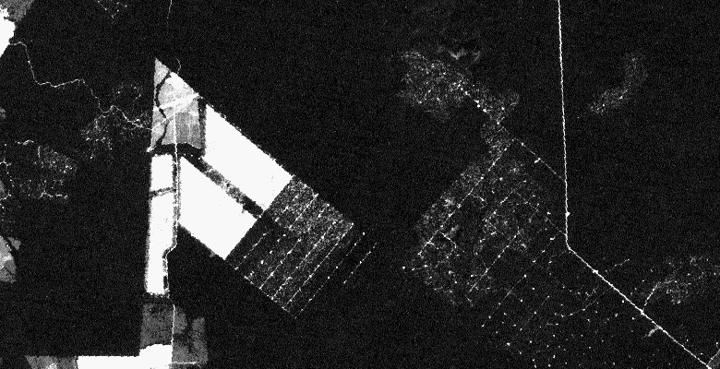
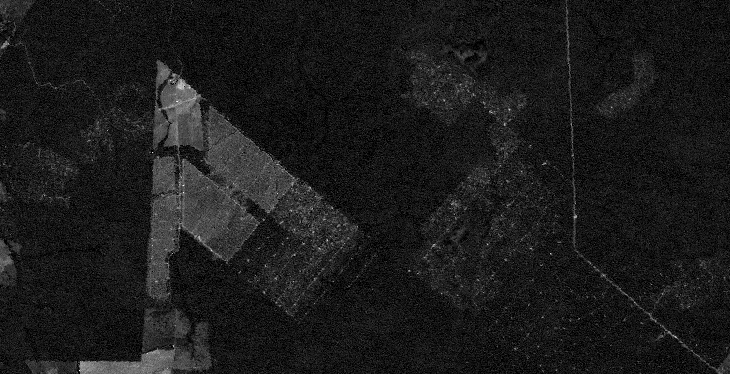
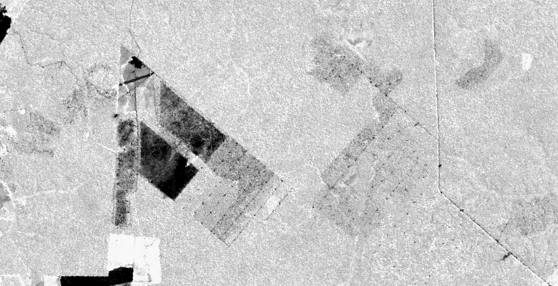
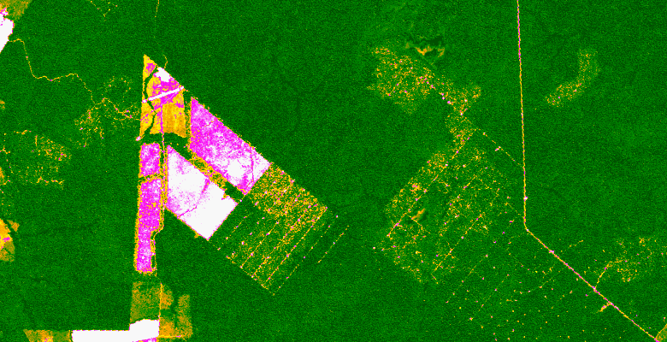

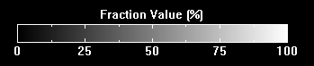
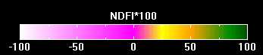
Combining fraction information to enhance forest degradation detection
Normalized Differencing Fraction Index (NDFI)
Paragominas,Pará State
Soil
NPV
Where GV is green vegeation, NPV is the nonphoto synthetic vegetation
GV
NDFI
-1 ≤ NDFI ≤1
NDFI values from 0.70 to 0.85 indicate canopy change that can be associated with forest degradation. NDFI can be rescaled to 0 to 200 to save disk space
Source: Souza Jr. 2005

Slide 39
Outline of lecture
Definition of forest degradation and IPCC GPG* context
Types of forest degradation
Approaches to assess forest degradation areas
  Monitoring forest degradation from selective logging
  Monitoring forest degradation from fuelwood collection
  Remote sensing approaches
    direct methods
    indirect methods
Software requirements
*GPG = Good Practice Guidance

Slide 40
Indirect approach to monitor forest degradation: Intact/nonintact forest
Direct remote sensing of forest degradation may not always be possible (e.g., in historical context).
An indirect method has been proposed, largely adapting the concepts developed to assess the world’s intact forest landscape in the framework of the IPCC Guidance and Guidelines for reporting GHG emissions and removals from forest land.
Notes:
Often a direct remote sensing approach to assess forest degradation cannot be adopted because of various limiting factors, which are even more restrictive if forest degradation has to be measured for a historical period, which can be observed only with remote sensing data available in the archives.
Moreover, the forest definition contained in the UNFCCC framework of provisions (UNFCCC 2001) does not discriminate between forests with different carbon stocks, and often forest land subcategories defined by countries are based on concepts related to different forest types (e.g., species compositions) or ecosystems than can be delineated through remote sensing data or through geo-spatial criteria (e.g. altitude). Consequently, any accounting system based on forest definitions that do not contain parameters related to carbon content will require an extensive and high intensive carbon stock measuring effort (e.g. national forest inventory) in order to report on emissions from forest degradation.
In this context—the need for activity data (area changes) on degraded forest under the UNFCCC reporting requirement and the lack of remote sensing data for an exhaustive monitoring system—a new methodology has been elaborated with the aim of providing an operational tool that could be applied worldwide. This methodology largely adapts the concepts and criteria already developed to assess the world’s intact forest landscape in the framework of the IPCC Guidance and Guidelines for reporting GHG emissions and removals from forest land.

Slide 41
Intact/nonintact forest approach: Basic concepts
Definitions:
  Intact forests: fully-stocked (any forest with its natural canopy cover between 10% and 100%)
  Nonintact forests: not fully-stocked (the forest has undergone some level of timber exploitation or canopy degradation)
This distinction should be applied in any forest land-use subcategories a country aims to report under UNFCCC.
Thus a country will also have to collect the corresponding carbon stock data to characterize each forest land subcategory.
Notes:
In this new context, the intact forest concept has been used as a proxy to identify forest land without anthropogenic disturbance so as to assess the carbon content present in the forest land:
Intact forests: fully stocked (any forest with tree cover between 10% and 100% but must be undisturbed, i.e., there has been no timber extraction)
Nonintact forests: not fully stocked (tree cover must still be higher than 10% to qualify as a forest under the existing UNFCCC rules, but in the new definition one assumes that in the forest has undergone some level of timber exploitation or canopy degradation).
This distinction should be applied in any forest land-use subcategory (forest stratification) that a country is aiming to report under UNFCCC. For example, if a country is reporting emissions from its forest land using two forest land subcategories—lowland forest and mountain forest—it should further stratify its territory using the intact approach and in this way it will report on four forest land subcategories: intact lowland forest, nonintact lowland forest, intact mountain forest, and nonintact mountain forest. Thus a country will also have to collect the corresponding carbon pools data in order to characterize each forest land subcategories.

Slide 42
Intact/nonintact forest approach: Definition of intact forest land
Defined according to parameters based on spatial criteria that could be applied objectively and systematically over all the country.
Country specific definition could be, e.g.:
  Situated within the forest land according to UNFCCC definitions and with a buffer zone inside the forest
  Containing a contiguous mosaic of natural ecosystems
  Not fragmented by infrastructure (road, navigable river, etc.)
  Without signs of significant human transformation
  Without burnt lands and young tree sites adjacent to infrastructure objects
Source: Potapov et al. 2008.
Notes:
The intact forest areas are defined according to parameters based on spatial criteria that could be applied objectively and systematically over all the country territory. Each country according to its specific national circumstance (e.g. forest practices) may develop its intact forest definitions.
These criteria with larger thresholds for minimum area extension and buffer distance have been used to map intact forest areas globally (www.intactforests.org).
These criteria can be adapted at the country or ecosystem level. For example the minimum extension of an intact forest area or the minimum width can be reduced for mangrove ecosystems. It must be noted that by using these criteria a nonintact forest area would remain nonintact for long time even after the end of human activities, until the signs of human transformation disappear.
Source:
Potapov et al. 2008.

Slide 43
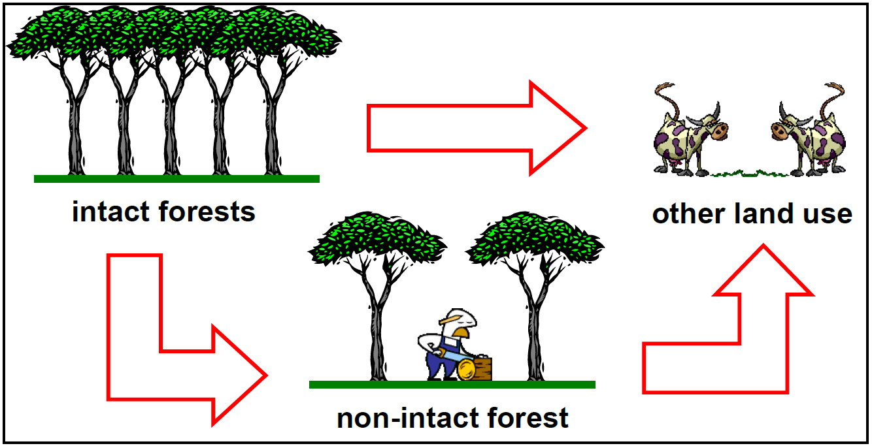
Intact/non-intact forest approach – Application to carbon accounting
Carbon emission from forest degradation for each forest type consists of two factors: 1) the difference in carbon content between intact and non-intact forests and 2) the area loss of intact forest area during the accounting period
Forest degradation is included in the conversion from intact to non-intact forest, and thus accounted as carbon stock change in that proportion of forest land remaining as forest land
Source: Mollicone et al. 2007.
Notes:
The distinction between intact and nonintact allows one to account for carbon losses from forest degradation, reporting this as a conversion of intact to nonintact forest. The degradation process is thus accounted for as one of the three potential changes illustrated in GOFC-GOLD Sourcebook (2014, fig. 2.2.7): from (i) intact forests to other land use, (ii) nonintact forests to other land use, and (iii) intact forests to nonintact forests.
In particular, carbon emission from forest degradation for each forest type consists of two factors: (i) the difference in carbon content between intact and nonintact forests and (ii) the area loss of intact forest area during the accounting period. This accounting strategy is fully compatible with the set of rules developed in the IPCC LULUCF Guidance and AFOLU Guidelines for the sections “Forest Land Remaining Forest Land.”
Source:
Mollicone et al. 2007.

Slide 44
Intact/nonintact forest approach: Land use change matrix
To → From ↓ |  | Forest land |  | Other land
 |  | “Intact (natural) forest” | “Non-intact forest”
Forest land | “Intact (natural) Forest” | Forest conservation | Forest degradation | Deforestation
 | “Nonintact forest” | Enhancement of C stocks (forest restoration) | Sustainable management of forests | Deforestation
Other land |  | - | Enhancement of C stocks (A/R)
Source: Bucki et al. 2012.
Notes:
This change matrix further illustrates the application of the intact/nonintact forest approach to carbon accounting for the purposes of REDD+. The changes taking place within forest land (within the red box) would be covered by the intact/nonintact forest mapping. Among the processes identified within REDD+, these include forest conservation, sustainable management of forests, forest degradation, and enhancement of forest carbon stock (forest restoration).
Source:
Bucki et al. 2012.

Slide 45
Intact/nonintact forest approach: Delineation of intact forest land
A two-step procedure could be used to exclude nonintact areas and delineate the remaining intact forest using the “negative approach”:
Exclusion of areas around human settlements and infrastructure and residual fragments of landscape smaller than 1,000 ha, based on topographic maps, GIS database, thematic maps, etc. This first (potentially fully automated) step would result in a candidate set of landscape fragments with potential intact forest lands
Further exclusion of nonintact areas and delineation of intact forest lands is done by fine shaping of boundaries, based on visual or semi-automated interpretation methods of high-resolution satellite images (~ 10-30 m pixel spatial resolution).
Notes:
The adoption of the intact concept is also driven by technical and practical reasons. In compliance with current UNFCCC practice it is the parties’ responsibilities to identify forests according to the established 10–100% cover range rule.
When assessing the condition of such forest areas using satellite remote sensing methodologies, the “negative approach” can be used to discriminate between intact and nonintact forests. Disturbance such as the development of roads can be easily detected, while the absence of such visual evidence of disturbance can be taken as evidence that what is left is intact. Disturbance is easier to unequivocally identify from satellite imagery than the forest ecosystem characteristics, which would need to be determined if one followed the “positive approach,” i.e., identifying intact forest and then determining that the rest is nonintact.
Following this approach, forest conversions between intact forests, nonintact forests, and other land uses can be easily measured worldwide through Earth observation satellite imagery; in contrast, any other forest definition (e.g. pristine, virgin, primary/secondary, etc.) is not always measurable.

Slide 46
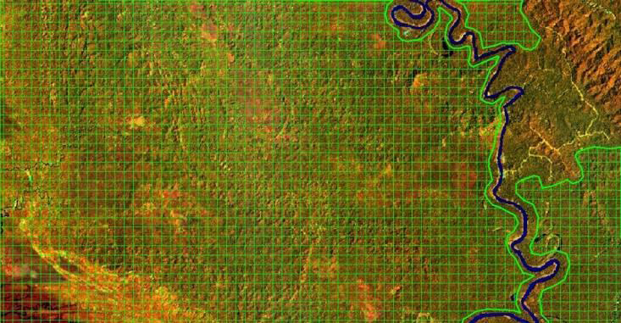
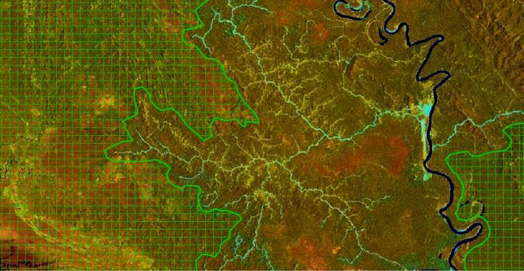
Intact/nonintact forest delineation example
(a) Papua New Guinea
December 26, 1988
(b) Papua New Guinea
October 7, 2002
The hashed areas are considered intact.
In the sample area, in 14 years, 51% of the existing intact forest land has been converted to nonintact forest land.
At the same time, deforestation accounts for less than 1% (roads).
Source: Potapov et al. 2008.
Notes:
This slide presents a practical example of delineation of forests into intact and nonintact areas on Landsat satellite images.
The images are from GOFC-GOLD Sourcebook (2014) figure 2.2.8, “Forest Degradation Assessment in Papua New Guinea.” The Landsat satellite images (a) and (b) represent the same portion of Papua New Guinea (PNG) territories in the Gulf Province and they have been acquired respectively in 26.12.1988 and 07.10.2002. In this part of the territory only lowland forest type is present. The patterned polygons represent the extent of the intact forest in the respective dates. In this case an on-screen visual interpretation method has been used to delineate intact forest boundaries.
In order to assess carbon loss from forest degradation for this part of its territory, PNG could report that in 14 years, 51% of the existing intact forest land has been converted to nonintact forest land. Thus the total carbon loss should be equivalent to the intact forest area loss multiplied by the carbon content difference between intact and nonintact forest land. In this particular case, deforestation (road network) is accounting for less than 1%. Area size: ~ 20km x 10 km
Source:
Potapov et al. 2008.

Slide 47
Another example of indirect method: Combining remote sensing detection and GIS to map selective logging
Detection of roads and log landing created by logging activity can be done with remote sensing.
Buffer distances can be applied using GIS to estimate the area affected by logging.
Source: Souza and Barreto 2000.
Notes:
Source: Souza, C. and Barreto, P. 2000.

Slide 48
Outline of lecture
Definition of forest degradation and IPCC GPG* context
Types of forest degradation
Approaches to assess forest degradation areas
  Monitoring forest degradation from selective logging
  Monitoring forest degradation from fuelwood collection
  Remote sensing approaches
    direct methods
    indirect methods
Software requirements
*GPG = Good Practice Guidance

Slide 49
Software to map forest degradation
Commercial software such as ENVI, ERDAS, PCI, and ArcGIS can be used to implement most of the methods discussed above.
Specialized software has been developed to deal specifically with the mapping and monitoring of forest degradation:
  CLASlite
  ImgTools (See Exercises)

Slide 50
In Summary
It is important to clearly define forest degradation and to set a benchmark for measuring carbon stock changes within a forest area.
Detection of forest degradation by earth observation is not always possible.
Different methodologies can be used to assess different types of forest degradation:
  Field observations and surveys
  Direct remote sensing methods
  Indirect remote sensing methods
Diverse commercial and open source software available for mapping forest degradation

Slide 51
Country examples and exercises
Country examples:
Peru: Monitoring forest degradation using CLASlite
Cameroon: Monitoring forest degradation using NDFI
Bolivia: Monitoring forest degradation using a combination of SMA fractions and NDFI
Exercises:
Monitoring forest degradation processes (logging), using ImgTools:
  Part 1: Introducing ImgTools
  Part 2: Forest Change Detection using SMA fractions and NDFI
  Part 3: Decision Tree Classification using a time-series of SMA and NFDI images
Intact/nonintact forest mapping using a proxy approach

Slide 52
Recommended modules as follow-up
Module 2.3 for methods to assess emission factors in order to calculate changes in forest carbon stocks.
Modules 3.1 to 3.3 to learn more about REDD+ assessment and reporting.

Slide 53
References
Bucki et al. 2012. “Assessing REDD+ Performance of Countries with Low Monitoring Capacities: The Matrix Approach.” Environmental Research Letters 7: 014031. http://iopscience.iop.org/1748-9326/7/1/014031/pdf/1748-9326_7_1_014031.pdf.
GFOI (Global Forest Observations Initiative). 2014. Integrating Remote-sensing and Ground-based Observations for Estimation of Emissions and Removals of Greenhouse Gases in Forests: Methods and Guidance from the Global Forest Observations Initiative. (Often GFOI MGD.) Geneva, Switzerland: Group on Earth Observations, version 1.0. http://www.gfoi.org/methods-guidance/.
Ghilardi, Adrian, Gabriela Guerrero, and Omar Masera. 2007. “Spatial Analysis of Residential Fuelwood Supply and Demand Patterns in Mexico Using the WISDOM Approach.” Biomass and Bioenergy 31 (7): 475–491. http://dx.doi.org/10.1016/j.biombioe.2007.02.003.
GOFC-GOLD (Global Observation of Forest Cover and Land Dynamics). 2014. A Sourcebook of Methods and Procedures for Monitoring and Reporting Anthropogenic Greenhouse Gas Emissions and Removals Associated with Deforestation, Gains and Losses of Carbon Stocks in Forests Remaining Forests, and Forestation. (Often GOFC-GOLD Sourcebook.) Netherland: GOFC-GOLD Land Cover Project Office, Wageningen University. http://www.gofcgold.wur.nl/redd/index.php.

Slide 54
Herold, M., et al. 2011. “Options for Monitoring and Estimating Historical Carbon Emissions from Forest Degradation in the Context of REDD+.” Carbon Balance and Management 6 (13). doi:10.1186/1750-0680-6-13. http://www.cbmjournal.com/content/6/1/13
Hosonuma, N., M. Herold, V. De Sy, R. De Fries, M. Brockhaus, L. Verchot, A. Angelsen, and E. Romijn. 2012. ”An Assessment of Deforestation and Forest Degradation Drivers in Developing Countries.” Environmental Research Letters 7 (4) 044009. doi:10.1088/1748-9326/7/4/044009.
Laurance, William F., and Carlos A. Peres. 2006. Emerging Threats to Tropical Forests. University of Chicago Press.
Mollicone, D., et al. 2007. “An Incentive Mechanism for Reducing Emissions from Conversion of Intact and Non-intact Forests.” Climatic Change 83: 477–93.
Morton, D., et al. 2011. “Historic Emissions from Deforestation and Forest Degradation in Mato Grosso, Brazil: 1) source data uncertainties.” Carbon Balance and Management 6 (18). doi:10.1186/1750-0680-6-18.
Pearson, T. R. H, S. Brown, and F. M. Casarim. 2014. “Carbon Emissions from Tropical Forest Degradation Caused by Logging.” Environmental Research Letters 9 (3): 034017. doi:10.1088/1748-9326/9/3/034017 https://www.winrock.org/wp-content/uploads/2016/03/Pearson-et-al-2014-Logging.pdf

Slide 55
Pearson, T. R. H, S. Brown, L.T. Murray, and G. Sidman. 2017. “Greenhouse gas emissions from tropical forest degradation: an underestimated source.” Carbon Balance and Management 12:3 https://link.springer.com/article/10.1186%2Fs13021-017-0072-2
Potapov, P., et al. 2008. “Mapping the World’s Intact Forest Landscapes by Remote Sensing.” Ecology and Society 13: 51. http://www.ecologyandsociety.org/vol13/iss2/art51/.
Simula, M. 2009. “Towards Defining Forest Degradation: Comparative Analysis Of Existing Definitions.” Working Paper 154, FAO, Rome. ftp://ftp.fao.org/docrep/fao/012/k6217e/k6217e00.pdf
Souza. 2012. “Monitoring of Forest Degradation.” In: Achard, F., Hansen, M.C. Global Forest Monitoring from Earth Observation. CRC Press. https://www.crcpress.com/product/isbn/9781466552012
Souza, C. and Barreto, P. 2000. An alternative approach for detecting and monitoring selectively logged forests in the Amazon. International Journal of Remote Sensing , 21, 173–179.
UNFCCC (United Nations Framework Convention on Climate Change). 2008. “Informal Meeting of Experts on Methodological Issues Related to Forest Degradation: Chair’s Summary of Key Messages.” Bonn, October 20–21. http://unfccc.int/methods_science/redd/items/4579.php.

